Slide 1
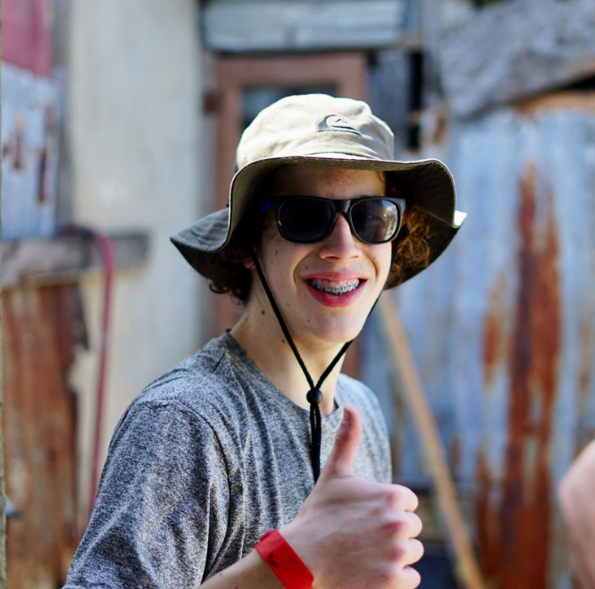

Carson Graham Global Initiatives and Leadership
Sosua Dominican Republic April 2024

Slide 2
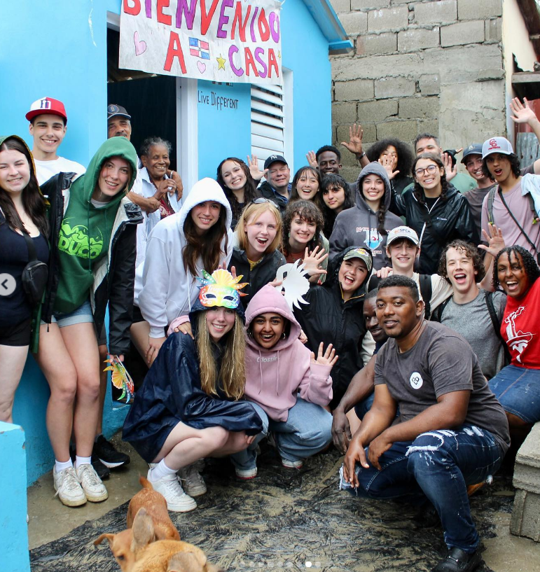

Dominican Republic Humanitarian Trip – March 11th – 20th 2024
10 Day Humanitarian trip including
Building
Teaching/Sports Program
Cultural Experience
Sightseeing
Pre-trip activities

Slide 3
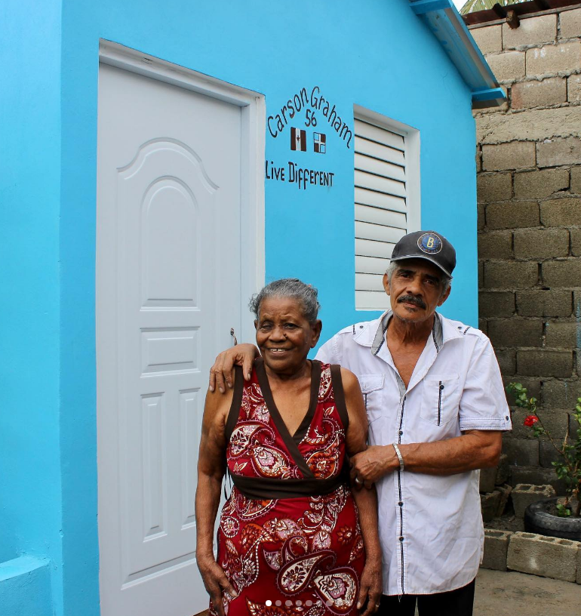
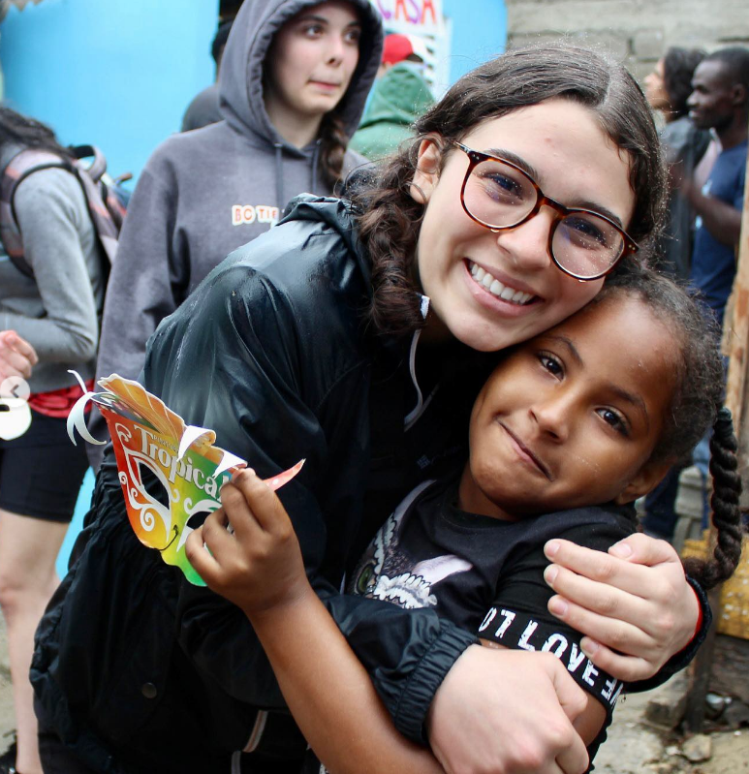
Mission

Slide 4
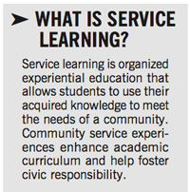
Global Initiatives 2024
Our focus is on leadership, personal development through student led initiatives, service, teamwork and trip preparation using the service learning model.
Open to students in grades 10, 11 and 12
Priority will be given to students who
have volunteer in our CI program
and are enrolled in the GI program.

Slide 5
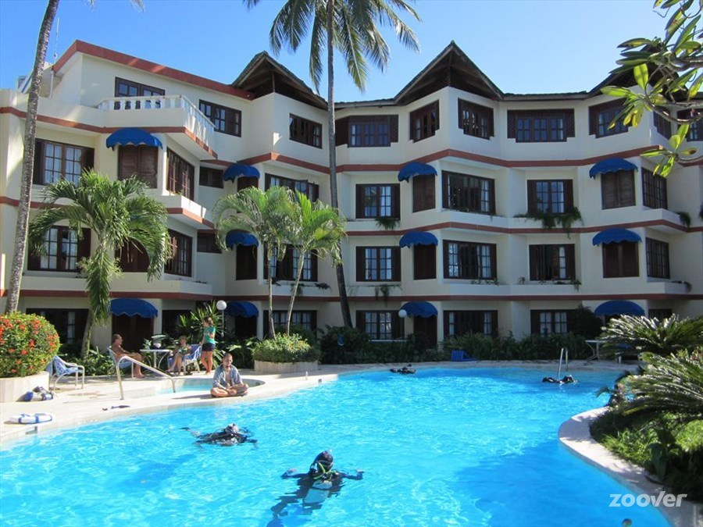
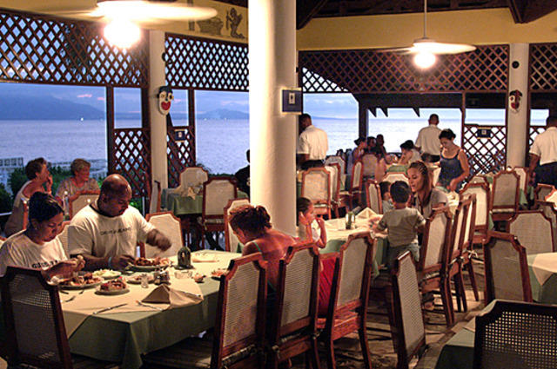
Accommodations
A safe and relaxing accommodation on the ocean.
Food and water are prepared safely.
24hr Security.
Clean accommodation for students to debrief and relax after a hot day.
Staff known by our school
staff.

Slide 6

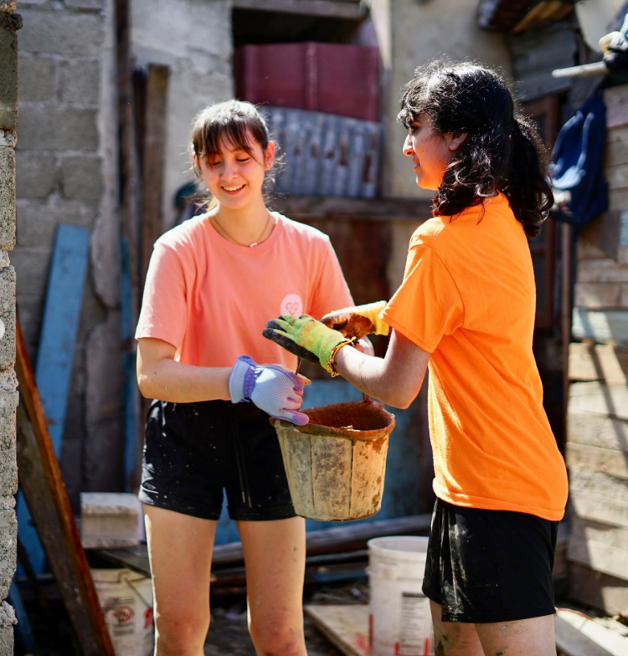
Safety
Considerations:
I have led several trips to same location
Last trip was March 2023
Live Different staff have extensive experience with teens.
24 hour security on enclosed property

Slide 7
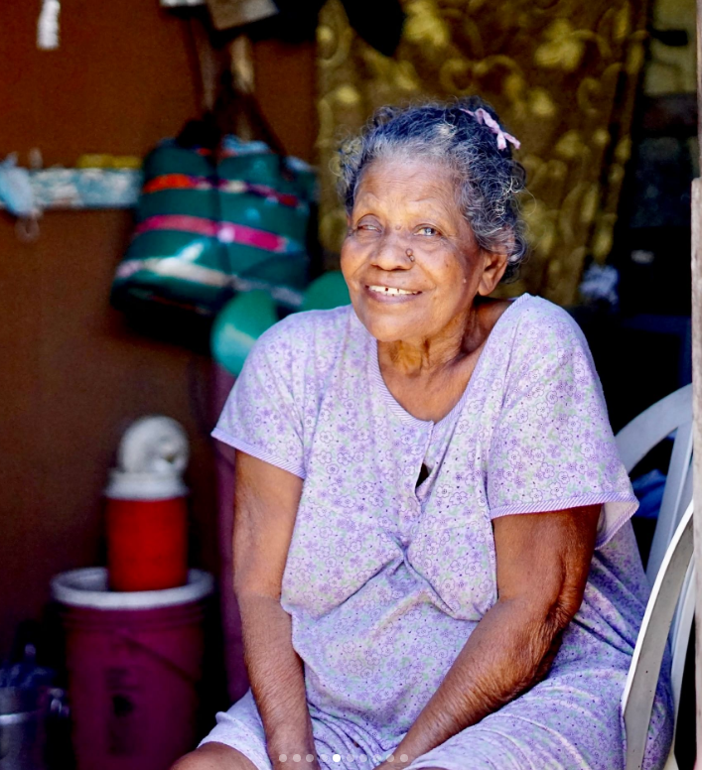
Global Initiatives and Carson
CG’s impact so far…
19 Houses built
1 Latrine built
1 Medical Clinic built
6 Communities worked in both Mexico and DR
1 Eye surgery
1 wheel chair and accommodation for Speacial need boy
470 Students lives positively impacted.

Slide 8
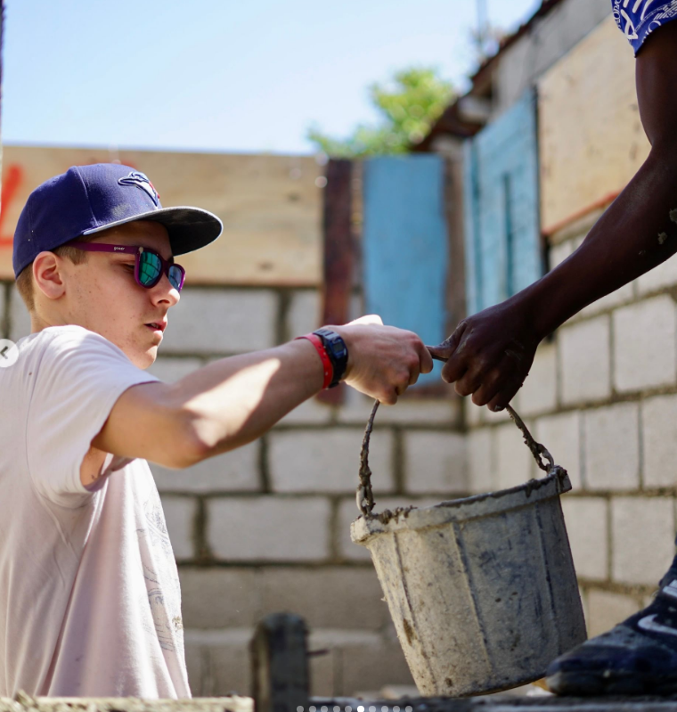
What you can also expect from our program
Excellent guest speakers relating to Global Issues
Experiential learning
Student lead activities
Caring and supportive environment
Sense of teamwork
Spanish Language component
Building safety component
Public speaking and reflection

Slide 9
Who this is for?
Students who are not afraid of hard work in rain, sun, and humid conditions.
People who want to make a difference.
Students who want to learn about culture, history, service and leadership through an invaluable travel experience.
Students who are open to new ideas and acting as servant leaders in their local and global community.
WHAT THIS CLASS IS NOT:
Just a resume builder
A group to save people
Easy

Slide 10
Trip Costs
Total cost = $5300.00
  Open Door travel
  $2170.00
  Responsible for booking air travel
  All insurance – travel, medical and cancellation
  Paid through Live Different for tax purposes.
  Live Different
  $3130.00
  Responsible for our time in the Dominican Republic, rooms, food, excursions, building costs, furnishing houses, land costs
  Donations = tax receipts
  Register online for the trip and pay online

Slide 11
Upcoming Meetings
Date | Reason | Location
September 19th, 2023 | Fundraising Meeting | E201
Jan TBD | Forms Meeting/ Shots | E202
Feb/ March TBD | Final Trip Meeting | E202

Slide 12
To Do:
Complete NVSD School Field trip
Complete Open Doors Travel form
Complete NVSD Medical form
Provide a colour photo of your child’s passport
Make Down Payment cheque to Carson Graham Secondary School and drop off in main office.
Register and submit $1000.00 down payment for flight and insurance
Other payments:
September 29th - $1000.00
January 5th - $3300.00
5. Come to our fundraising meeting on September 19th at 7:00 in E201

Slide 13
Contacts
Trip Organizers
Mr. Rob Olson - Rolson@sd44.ca website: http://globalinitiativesandleadership.weebly.com/
Ms. Chanel Stanley Cstanley@sd44.ca
Mr. Lucas Mann Lmann@sd44.ca
Live Different Contact - Jennifer Quong or phone 1-866-432-4464
Open Doors travel agent – Erika 778-317-9267

Slide 14
Questions?

